Slide 1

Linear models in agriculture and natural resources
Overview of Stats process

Slide 2

Outline for today
Morning
Lecture [2 hours, including Q&A]
  Stats basics
  Overview of Stats process
Worked example in R [1 hours, including Q&A]
Afternoon
Data visualization [30 – 60 min]
Lecture [45 min]
  Repeated measures and temporal autoregressive
  Quadratic regression
Worked example in R Part II [1 hours]

Slide 3

ALS6502C Course Manual
https://hahnp13.github.io/ALS6502C-LMANR-Manual/

Slide 4
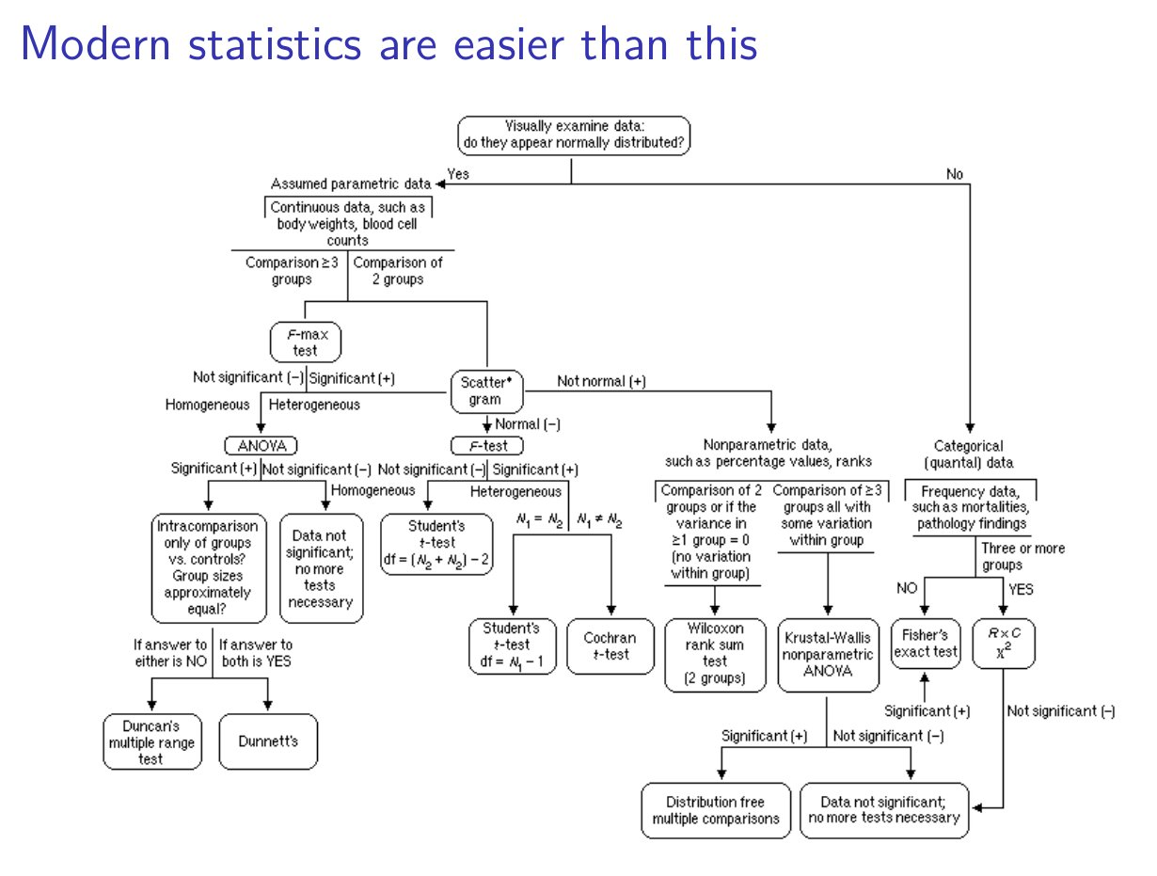
Francisco Rodriguez-Sanchez
https://frodriguezsanchez.net

Slide 5
Francisco Rodriguez-Sanchez
https://frodriguezsanchez.net

Slide 6
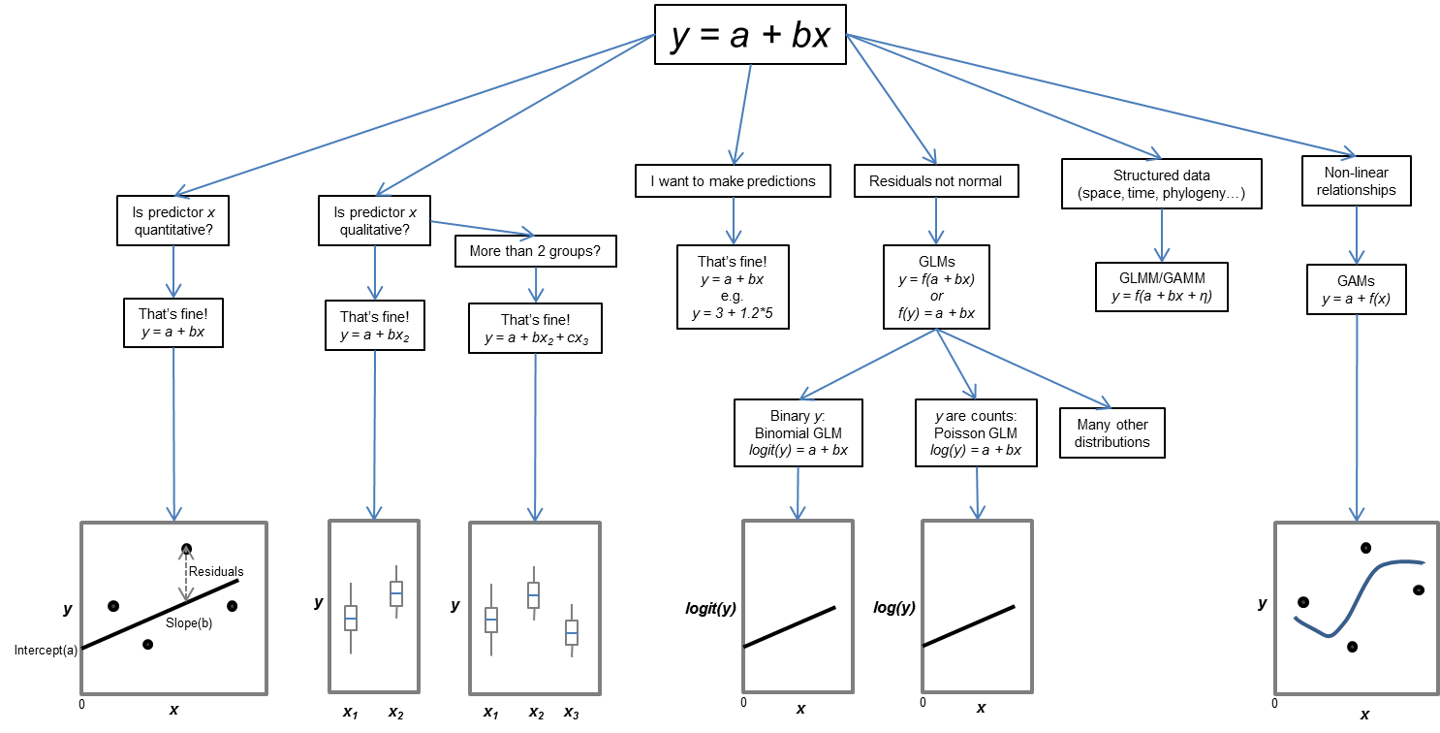
Francisco Rodriguez-Sanchez
https://frodriguezsanchez.net

Slide 7


Slide 8
What is a probability distribution?
A measure of how spread out the data values are from the mean
A mathematical description of a random phenomenon that gives the probability of possible events
A summary statistic that describes the center of a data set
An estimate of the variability, or precision, of a sample mean

Slide 9
What is a probability distribution?
A measure of how spread out the data values are from the mean
A mathematical description of a random phenomenon that gives the probability of possible events
A summary statistic that describes the center of a data set
An estimate of the variability, or precision, of a sample mean

Slide 10
What is a mean?
A measure of how spread out the data values are from the mean
A mathematical description of a random phenomenon that gives the probability of possible events
A summary statistic that describes the center of a data set
An estimate of the variability, or precision, of a sample mean

Slide 11
What is a mean?
A measure of how spread out the data values are from the mean
A mathematical description of a random phenomenon that gives the probability of possible events
A summary statistic that describes the center of a data set
An estimate of the variability, or precision, of a sample mean

Slide 12
What is a standard deviation?
A measure of how spread out the data values are from the mean
A mathematical description of a random phenomenon that gives the probability of possible events
A summary statistic that describes the center of a data set
An estimate of the variability, or precision, of a sample mean

Slide 13
What is a standard deviation?
A measure of how spread out the data values are from the mean
A mathematical description of a random phenomenon that gives the probability of possible events
A summary statistic that describes the center of a data set
An estimate of the variability, or precision, of a sample mean

Slide 14
Questions ???
Notes:
Allan

Slide 15
What is a probability distribution?
Normal (Gaussian) distribution
Continuous numeric variables
  -∞ to ∞
  Most points near the mean
  Points symmetrically distributed around mean
Parameters
  μ = Mean
  σ² = Variance
    σ = Standard deviation

Slide 16
What is a probability distribution?
Normal (Gaussian) distribution
Continuous numeric variables
  -∞ to ∞
  Most points near the mean
  Points symmetrically distributed around mean
Parameters
  μ = Mean
  σ² = Variance
    σ = Standard deviation

Slide 17
What is a probability distribution?
Normal (Gaussian) distribution
Continuous numeric variables
  -∞ to ∞
  Most points near the mean
  Points symmetrically distributed around mean
Parameters
  μ = Mean
  σ² = Variance
    σ = Standard deviation
Mean = 0
SD = 1
Mean = 0
SD = 2

Slide 18

What processes generate data?
Data are the result of natural (or biological) phenomena
Phenomena is mathematically described by a probability distribution
Data we observe are a random subset of events produced by a phenomenon
Used to model data in statistical analysis and make inferences
Natural processes
Probability distribution
Observed data
Model / inference
count
Predictor variable

Slide 19
Steps for constructing and interpreting a GLMM
0. Data Exploration
Construct model
  Fixed effects (predictor or explanatory variables)
  Random effects (blocking variables)
  Error distribution (response variable or dependent variable)
Assess residuals and overdispersion
Check random effects and/or distribution using AIC (not always needed)
Examine significance of terms in model
  Anova
  AIC model selection
Calculate treatment means and/or slopes
Construct contrasts
Calculate R2m and R2c
Make pretty figure

Slide 20
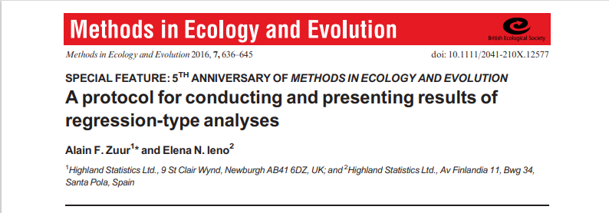

Slide 21
Step 0: Data exploration
Plot data, check for outliers/errors.
Check distribution, etc.
  Justify subsetting, transformation decisions a priori
    Or at least for biological reasons
  Avoid making decisions based on your specific dataset

Slide 22
Step 1. Construct a statistical model to test your hypothesis
1. Construct a statistical model to test your hypothesis.
  Linear model: y ~ x1 + x2 + x1:x2
  Random effects?
  Distribution? Gaussian okay or generalized model?

Slide 23
Step 1. Construct a statistical model to test your hypothesis
Linear model: y_{i} ~ μ + β + e_{i}
Residual variation or error
Response
variable
mean
Parameter estimate to change the
mean based on some variable
(ie. slopes or intercepts)

Slide 24
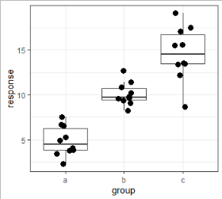
Step 1. Construct a statistical model to test your hypothesis
“Linear regression”: y_{i} ~ B₀ + B₁X + e_{i}
“ANOVA” model: y_{ij} ~ B₀ + β_{i} + e_{ij}
intercept
slope
resid
intercept
resid
Adjustment to intercept
for each group

Slide 25
ANOVA as a linear model
“ANOVA” model: y_{ij} ~ B₀ + β_{j} + ε_{ij}
  y_{ij} is the observation for individual i in group j
  B₀ is the mean for the first (alphabetical) group
  B_{j} is the mean for group j
  e_{ij} is how far each obs is from its group mean
    or the random variation in the data
    Follows a normal distribution

Slide 26
ANOVA as a linear model
“ANOVA” model: y_{ij} ~ B₀ + β_{j} + ε_{ij}
  y_{ij} is the observation for individual i in group j
  B₀ is the mean for the first (alphabetical) group
  B_{j} is the mean for group j
  e_{ij} is how far each obs is from its group mean
    or the random variation in the data
    Follows a normal distribution
~B
~W

Slide 27
ANOVA as a linear model
“ANOVA” model: y_{ij} ~ B₀ + β_{j} + ε_{ij}
  y_{ij} is the observation for individual i in group j
  B₀ is the mean for the first (alphabetical) group
  B_{j} is the mean for group j
  e_{ij} is how far each obs is from its group mean
    or the random variation in the data
    Follows a normal distribution
~B (ie. how different the group means are)
~W (ie. how much var
w/in group)

Slide 28
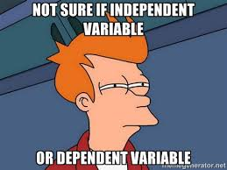
Questions ???
Notes:
Phil

Slide 29
Linear mixed models
“ANOVA” model: y_{ij} ~ B₀ + β_{i} + e_{ij}
“RCBD”: y_{ij} ~ B₀ + β_{i} + α_{j} + e_{ij}
response
Random effect (ie. random intercepts for blocks)
Predictor variable or fixed effects (ie. different intercepts for treatment means)

Slide 30
Fixed vs. random effects?
Fixed effects
Random effects

Slide 31
Fixed vs. random effects?
Fixed effects
Random effects
Usually the factor(s) of interest in study (or covariates)
Same anywhere you do it
  Values are meaningful and not exchangeable
Represent all possible levels of a factor (of interest)
  Same for continuous variables
Conclusions restricted to those levels
(group effects)

Slide 32
Fixed vs. random effects?
Fixed effects
Random effects
Usually the factor(s) of interest in study (or covariates)
Same anywhere you do it
  Values are meaningful and not exchangeable
Represent all possible levels of a factor (of interest)
  Same for continuous variables
Conclusions restricted to those levels (group effects)
Usually not the focus of study
Levels (categories) could be exchanged/substituted (eg. Individuals or blocks)
Represent a (random) sample of a larger set of levels
Can extrapolate conclusions to the larger sample (population level)
Different statistical properties

Slide 33
Random effects in experiments vs. observational studies
Much more control in experiments
Less control in observation surveys
  Depends on data type/structure/
Pseudo-replication can be a problem in both

Slide 34
Benefits of blocking
Blocks are formed so that treatments within blocks are as homogenous as possible
Treatments randomly assigned within blocks
Used to reduce variation among experimental units
  Allows to account for variation from block-to-block
Ensures interspersion among treatments
Can account for pseudo-replication (when present)

Slide 35
Rules of thumb about random effects
Sometimes it’s a judgement call of whether something should be fixed or random
Random effects should have at least 5 levels (and typically much more)
  5+ blocks, 5+ populations, 5+ clutches
Each level of a random effect should have >3 observations
  For most levels
  Ok if a few levels have only a few observations
  Should be relatively balanced among levels (but not perfectly)
Harrison et al. (2018), A brief introduction to mixed effects modelling and multi-model inference in ecology. PeerJ 6:e4794; DOI 10.7717/peerj.4794

Slide 36
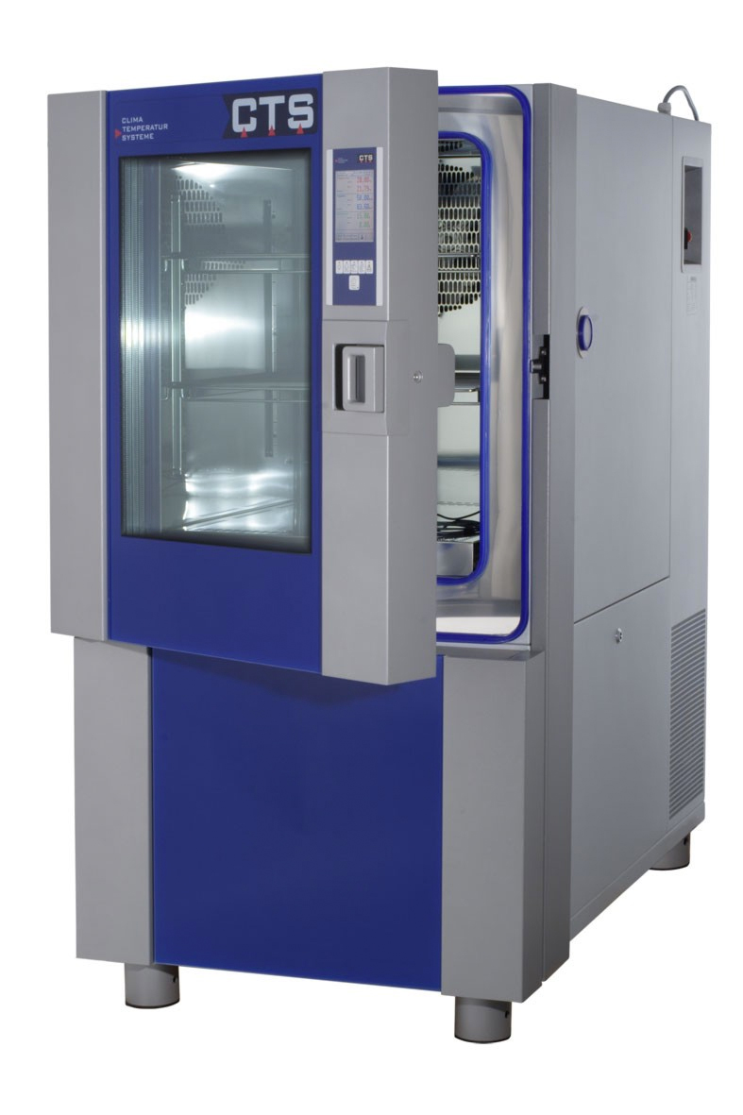
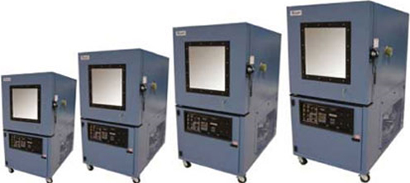
Examples of blocks
Chambers or tanks

Slide 37
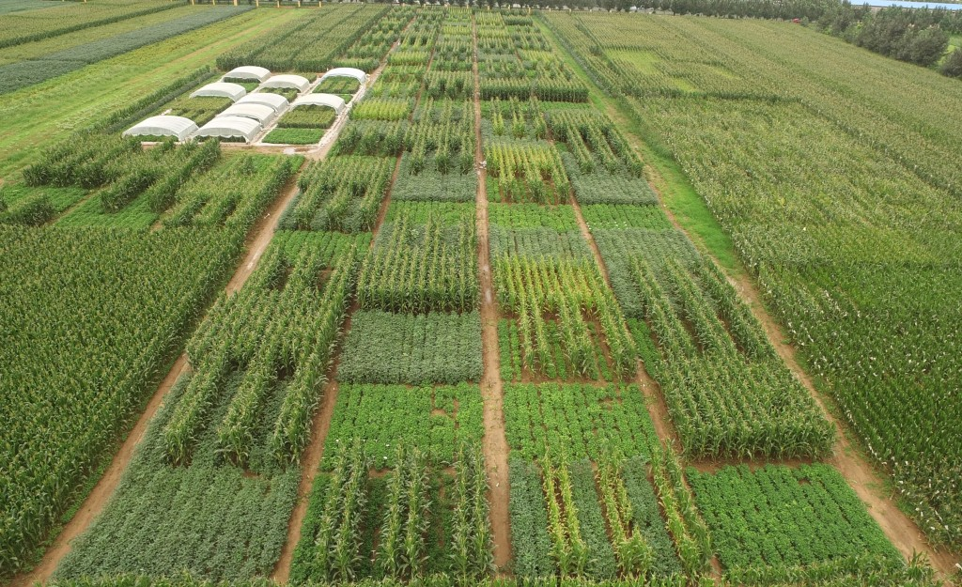
Examples of blocks
Fields

Slide 38
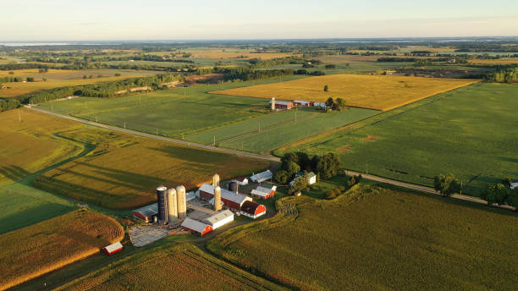
Examples of blocks
Farms

Slide 39




Examples of blocks
Parent – siblings all similar to each other

Slide 40


Examples of blocks
Individuals/subjects
Repeated measures
PRE
POST

Slide 41
Examples of blocks
Individuals/subjects
Repeated measures
Time 1
Time 2
Time 3

Slide 43
Which of the following would be characteristics typical of a FIXED effect in a statistical model? (select all that apply)
A factor of direct interest hypothesized to affect your response variable
A factor not of direct interest to the study which might have an unintended effect on your response variable
Values or levels are meaningful and the same anywhere you conducted the experiment
Values or levels could be exchanged or substituted
Values or levels represent a random subset of possible levels of the factor
Conclusions are restricted to the levels imposed
Conclusions can be extrapolated to the larger population

Slide 44
Which of the following would be characteristics typical of a FIXED effect in a statistical model? (select all that apply)
A factor of direct interest hypothesized to affect your response variable
A factor not of direct interest to the study which might have an unintended effect on your response variable
Values or levels are meaningful and the same anywhere you conducted the experiment
Values or levels could be exchanged or substituted
Values or levels represent a random subset of possible levels of the factor
Conclusions are restricted to the levels imposed
Conclusions can be extrapolated to the larger population

Slide 45
Which of the following would be characteristics typical of a RANDOM effect in a statistical model? (select all that apply)
A factor of direct interest hypothesized to affect your response variable
A factor not of direct interest to the study which might have an unintended effect on your response variable
Values or levels are meaningful and the same anywhere you conducted the experiment
Values or levels could be exchanged or substituted
Values or levels represent a random subset of possible levels of the factor
Conclusions are restricted to the levels imposed
Conclusions can be extrapolated to the larger population

Slide 46
Which of the following would be characteristics typical of a RANDOM effect in a statistical model? (select all that apply)
A factor of direct interest hypothesized to affect your response variable
A factor not of direct interest to the study which might have an unintended effect on your response variable
Values or levels are meaningful and the same anywhere you conducted the experiment
Values or levels could be exchanged or substituted
Values or levels represent a random subset of possible levels of the factor
Conclusions are restricted to the levels imposed
Conclusions can be extrapolated to the larger population

Slide 47
Step 1. Construct a statistical model to test your hypothesis
Table of R functions for constructing linear models
Function | Type of model | Type of test | Distribution | Package
lm() | Linear model | Regression, ANOVA, ANCOVA | Gaussian | Base R
lmer() | Linear mixed-effects models | Blocked or split-plot ANOVAs, nested designs, repeated measures. | Gaussian | lme4
glmer() | Generalized linear mixed-effects models | Blocked or split-plot ANOVAs, nested designs, repeated measures. | Poisson, Binomial | lme4
glmmTMB() | Any type of linear models, including generalized linear (mixed) models | Blocked or split-plot ANOVAs, nested designs, repeated measures. | Poisson, Binomial, Gamma, and many others | lme4, glmmTMB

Slide 48

Break
Notes:
Allan

Slide 49
Step 2. Check model assumptions

Slide 50
Assumptions of linear models
Response variable errors (ie. residuals) normally distributed
Residuals should be normally distributed
Notes:
Data might not be “normally” distributed, but the residuals can be (or vice versa). Its only important that the residuals are normally distributed

Slide 51
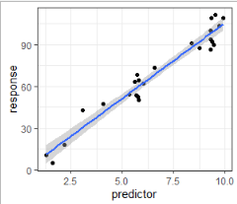
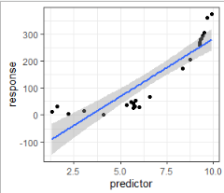
Assumptions of linear models
Response variable errors (ie. residuals) normally distributed
Linearity
Good
Bad

Slide 52
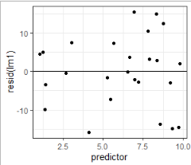
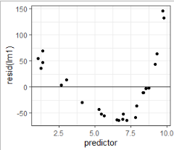
Assumptions of linear models
Response variable errors (ie. residuals) normally distributed
Linearity
Homoscedasticity
Good
Bad
Residuals should be evenly scattered around zero when plotted against the original predictor

Slide 53
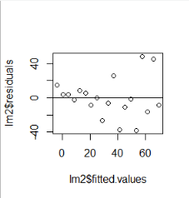
Assumptions of linear models
Response variable errors (ie. residuals) normally distributed
Linearity
Homoscedasticity
Good
Bad
Residuals should be evenly scattered around zero when plotted against the original predictor

Slide 54
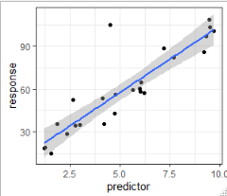
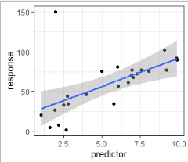
Assumptions of linear models
Response variable errors (ie. residuals) normally distributed
Linearity
Homoscedasiticy
Outliers
Good
Okay
Bad

Slide 55
Often data (and residuals) are not normally distributed

Slide 56

Why might we need to use non-normal distributions?
Linear models are reasonably robust to violations of the assumptions
Violations can affect
  P-values
  Standard errors
  Parameter estimates
Generalized models provide a better fit to the data
  P-values
  Standard errors
  Parameter estimates
Reviewers and editors expect it

Slide 57
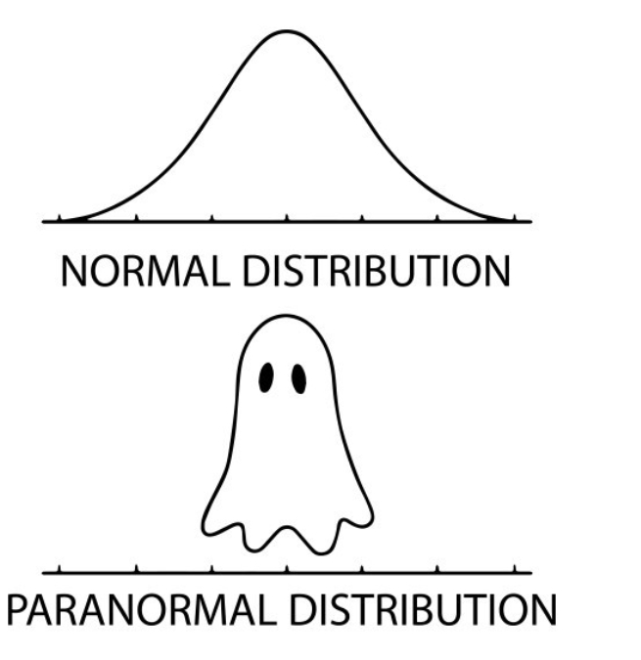
Questions ???
Notes:
Phil

Slide 58
What are “generalized” models?
Linear models that allow for more flexible error distributions
Parameters estimated via maximum likelihood (not least squares)
Model components
  Linear predictor formula ( y ~ x )
  Error distribution (usually exponential family)
  Link function: links distribution to linear predictor formula
    ie. Transforms error distribution to linear
Generalized linear mixed model
  Allows fixed and random effects

Slide 59
Generalized linear mixed models
Linear model: y_{ij} ~ μ + β_{i} + ε_{ij}
Linear mixed model: y_{ij} ~ μ + α_{i} + β_{j} + ε_{ij}
Generalized linear mixed model: log(y_{ij}) ~ μ + α_{i} + β_{j} + ε_{ij}

Slide 60
Poisson linear model
Parameters
Intercept
Slope
log(y_{i}) ~ β₀ + β₁X_{i}
Response
variable
Predictor
variable
Data

Slide 61
Poisson linear model
Parameters
Intercept
Slope
Link function:
Relates x to log(y)
on linear scale
Works on predicted
values (λ_{i})
Doesn’t transform
raw data
log(λ_{i}) ~ β₀ + β₁X_{i}
Response
variable
(predicted)
Predictor
variable
Data

Slide 62
Poisson linear model
log(λ_{i}) ~ β₀ + β₁X_{i}
=
λ_{i} ~ e^{β0 + β1Xi}

Slide 63
Poisson linear model – example 1
Counts across temp (continuous, 1 to 30):
log(λ_{i}) ~ β₀ + β₁X_{i}
yi ~ -0.3 + 0.14*X_{i}
log(λ_{i}) ~ -0.94 + 0.08*X_{i}
λ_{i} ~ e(-0.94 + 0.08*X_{i})

Slide 64
Poisson linear model – example 1
Counts across temp (continuous, 1 to 30):
log(λ_{i}) ~ β₀ + β₁X_{i}

Slide 65
Common distributions
Normal (gaussian)
Continuous numeric
Parameters
  Mean
  Variance (SD)
Link = identity (none)

Slide 66
Common distributions
Normal (gaussian)
Continuous numeric
Parameters
  Mean
  Variance (SD)
Link = identity (none)
Negative binomial
Counts
Parameters
  mu (mean)
  phi (precision)
    Inverse of dispersion
Link = log

Slide 67
Common distributions
Normal (gaussian)
Continuous numeric
Parameters
  Mean
  Variance (SD)
Link = identity (none)
Negative binomial
Counts
Parameters
  mu (mean)
  phi (precision)
    Inverse of dispersion
Link = log
Binomial
Proportions
  Presence/absence or ratio
Parameters
  Probability
  # trials
Link = logit
Prob = 0.20

Slide 68
Negative binomial distribution - assumptions
Discrete probability distribution
  Integers: number of events
  Events occur randomly (follow Poisson distribution)
  Account for “extra” variation
  (beyond poisson)
Parameters
  μ = mean
  φ = overdispersion parameter
    lower values are more overdispersion
    higher values converge to Poisson
  Var = μ + μ² / φ
  Link function = log

Slide 69
Common types of distributions
Distribution | Type of data | Overdisperion parameter? | Link
Gaussian | Continuous numeric variable | Yes | Identity
Log-normal | Continuous numeric variable | Yes | Identity
Poisson | Integers, counts | No | Natural log
Negative binomial | Integers, counts | Yes | Natural log
Binomial | Success/failure, presence/absence, ratio | No | Logit, cloglog
Beta-binomial | Success/failure, presence/absence, ratio | Yes | Logit, cloglog
Beta | Proportion (when the denominator is not known) | Yes | Logit
ordbeta | Proportion (when the denominator is not known), can have zero’s | Yes | Logit
Gamma | Positive continuous variable | Yes | Inverse, log
ziGamma | Positive continuous variable, can haze zero’s | Yes | log

Slide 70
What distribution best matches the data?
Description of data
Distribution
Concentrations of chemicals in the soil, most values are low (~0.1 ug/L) but some are high (5-10 ug/L)
Number of infected and uninfected aphids on plants
Percent damage on leaves caused by herbivore or pathogens
Number of thrips on a plants
Normal
Log-normal
Poisson
Negative binomial
Binomial
Beta
Gamma

Slide 71
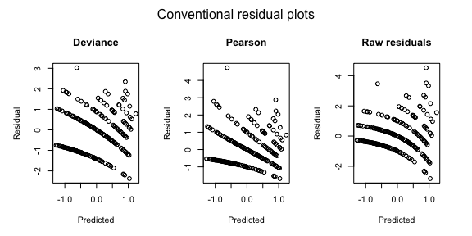
Step 2. Check GLM assumptions
“Conventional” residuals don’t work well for non-normal data
This figure shows residuals fit for count data assuming a Poisson distribution.
The model (not shown) fits the data well, although the residuals look wonky.

Slide 72
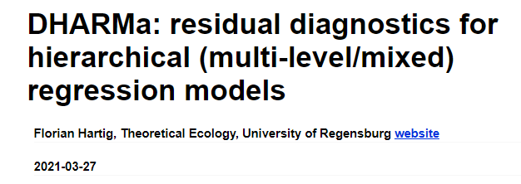
Step 2. Check GLM assumptions
“Regular” residuals often don’t work well for non-normal data
Simulated residuals offer a great diagnostic tool
DHARMa stands for “Diagnostics for HierArchical Regression Models”
https://cran.r-project.org/web/packages/DHARMa/vignettes/DHARMa.html

Slide 73
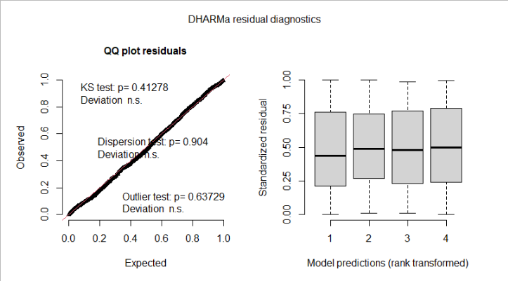
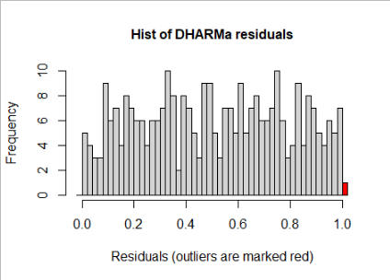
Step 2. Check GLM assumptions
“Regular” residuals often don’t work well for non-normal data
Simulated residuals offer a great diagnostic tool
https://cran.r-project.org/web/packages/DHARMa/vignettes/DHARMa.html

Slide 74
Reasons for deviations of residuals
Mis-specified model
  Incorrect distribution (or potentially link function)
  Missing fixed effect
    Include additional covariates, if available
    Check outliners in covariates or influential data points
    Include quadratic term
  Incorrect random-effect structure
    Missing block or nestedness?
    Incorrect order of nesting?
Overdispersion (return to this later)
Zero-inflation

Slide 75
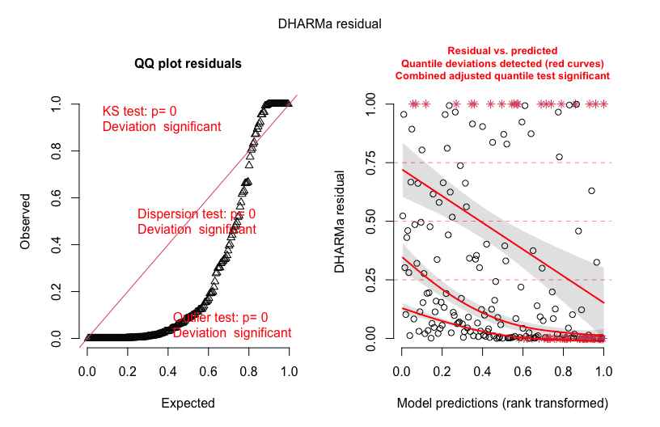
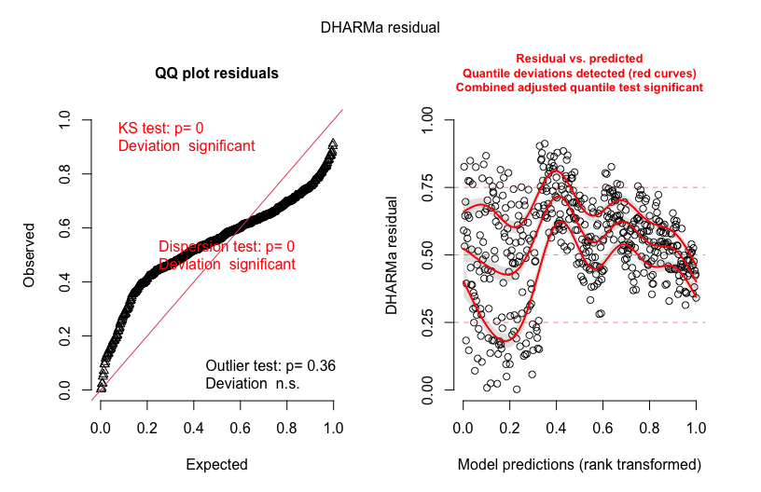
Step-by-step guide to analysis
(post-data collection)
2. Check model assumptions
Bad residuals (overdispersion)
Bad residuals (wrong dist., overfitting, etc.)

Slide 76

What is overdispersion?
More variation in the data than expected based on the distribution
Poisson: λ = mean = variance
Most count data: variance > mean
Check: φ = Σ Pearson Resid^2/df
  High values = more overdispersion
  Alt: θ = overdispersion parameter
    lower values are more overdispersion
    higher values converge to Poisson
Need to correct!
Harrison 2014

Slide 77
Processes that generate overdispersion
Missing co-variates or random effects
Sampling (counting) errors
Non-independent (ie. aggregated) data
Environmental stochasticity
Many zeros (mixture of above, others, unknown)
Gelman and Hill 2007
Linden and Mantyniemi 2011 Ecology

Slide 78
What are consequences of overdispersion?
Confidence intervals too small
P-values too low, leading to Type I error
Biased parameter estimates

Slide 79
Step-by-step guide to analysis
(post-data collection)
3. Check model parameters using summary()
  Most useful for random effects and sometimes continuous variables (regression)
Function | Coefficients | Notes
lm() | Helpful to look at for slopes from regressions. Not that helpful for categorical variables. | Also helpful is R-square
lmer() | Helpful to look at for slopes from regressions. Not that helpful for categorical variables. Random effect variance components. | Singularity (VC=0) can be an issue.
glmmTMB() | Helpful to look at for slopes from regressions. Remember slopes predict transformed (via link function) values. Random effect variance components. | Singularity (VC=0) can be an issue. Output doesn’t provide resid deviance.

Slide 80
Step 3. Check random effects and model components
3. Check random effects using AIC or LRT
  Not always necessary
    Not all models have/need random effects and non-normal distributions
  Can use summary() to look at random effect variance components
    Singularity can be worth noting (very small VC is almost singular)
Will demo this in worked example

Slide 81

Questions ???
Notes:
Allan

Slide 82
Step 4. Check significance of terms in model
Where do p-values come from?
Estimate parameter values (i.e., slopes or intercepts)
Calculate a test-statistic
Use a distribution to find your p-value
Alternative method is AIC model selection

Slide 83
Step 4. Check significance of terms in model
4. Check significance of terms in model
  Most useful for categorical variables
  Optional (for if using AIC model selection)
Function | ANOVA table function | Test
lm() | car::Anova(model, type=2) | Analysis of variance, F test
lmer() | lmerTest::anova(model) – best option Or car::Anova(model, type=2) | Analysis of variance, F test
glmmTMB() | car::Anova(model, type=2) | Analysis of deviance, Wald χ2 test

Slide 84


Methods to estimate parameters
Least squares
Maximum likelihood
Minimizes the sums of squares
$\sum{(y_{i}− \overline{y}}$)²
Maximizes the likelihood function
$ℒ\left(\text{β} | y\right)$

Slide 85




Least squares estimation
Minimizes the sums of squares
$\sum{(y_{i}− \overline{y}}$)²
β = slope; Fit represents $\overline{y}$
$$y_{i}− \overline{y}$$
β = 0
β = 1
β = -1
$$y_{i}− \overline{y}$$
y
y
y
$$y_{i}− \overline{y}$$
x
x
x

Slide 86

Maximum likelihood estimation
Maximizes the likelihood function
$ℒ\left(\text{β} | y\right)$: How likely is β given the observed data (y)
β = slope
β = -1
Likelihood of
observing the data
y
x
-1
0
1
Parameter value

Slide 87

Maximum likelihood estimation
Maximizes the likelihood function
$ℒ\left(\text{β} | y\right)\text{: }\text{How} \text{likely}\text{ (}\text{probable}\text{) }\text{is} \text{β} \text{given} \text{the} \text{observed} \text{data}\text{ (}\text{y}\text{)}$
$\text{β}\text{ = }\text{slope}$
β = 0
Likelihood of
observing the data
y
x
-1
0
1
Parameter value

Slide 88

Maximum likelihood estimation
Maximizes the likelihood function
$ℒ\left(\text{β} | y\right)\text{: }\text{How} \text{likely}\text{ (}\text{probable}\text{) }\text{is} \text{β} \text{given} \text{the} \text{observed} \text{data}\text{ (}\text{y}\text{)}$
$\text{β}\text{ = }\text{slope}$
β = 1
Likelihood of
observing the data
y
x
-1
0
1
Parameter value

Slide 89

Maximum likelihood estimation
Maximizes the likelihood function
$ℒ\left(\text{β} | y\right)\text{: }\text{How} \text{likely}\text{ (}\text{probable}\text{) }\text{is} \text{β} \text{given} \text{the} \text{observed} \text{data}\text{ (}\text{y}\text{)}$
$\text{β}\text{ =} \text{slope}$
β = 2
Likelihood of
observing the data
y
x
-1
0
1
Parameter value

Slide 90


Methods to estimate parameters
Least squares
Maximum likelihood
Minimizes the sums of squares
$\sum{(y_{i}− \overline{y}}$)²
β = slope or intercept adjust
Only works for normal data
Maximizes the likelihood function
$ℒ\left(\text{β} | y\right)$
β = slope or intercept adjust
Can be generalized to any distribution
β = 1

Slide 91
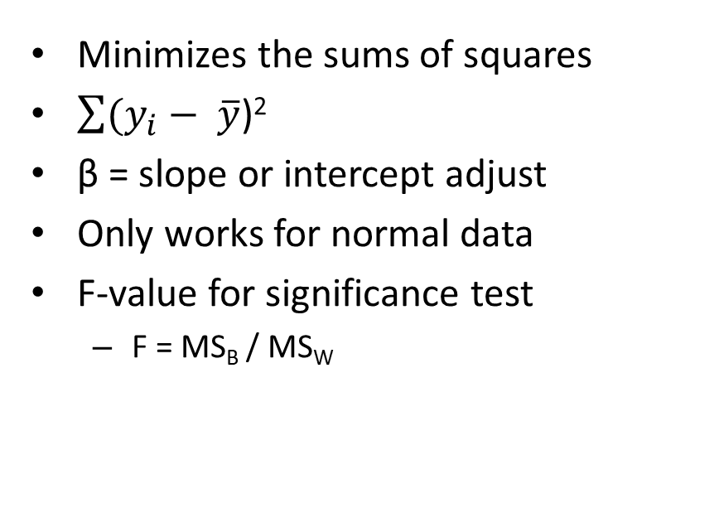
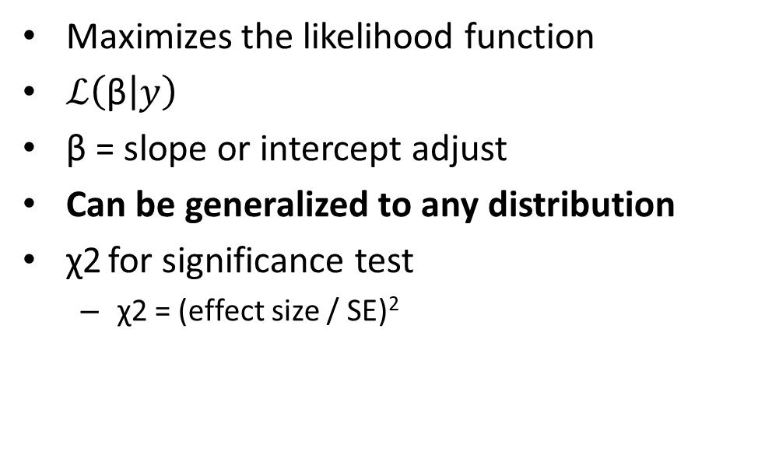
Methods to estimate parameters
Least squares
Maximum likelihood
Minimizes the sums of squares
$\sum{(y_{i}− \overline{y}}$)²
β = slope or intercept adjust
Only works for normal data
F-value for significance test
  F = MS_{B} / MS_{W}
Maximizes the likelihood function
$ℒ\left(\text{β} | y\right)$
β = slope or intercept adjust
Can be generalized to any distribution
χ2 for significance test
  χ2 = (effect size / SE)²
Notes:
MS come from the Sums of squares divided by the DF

Slide 92
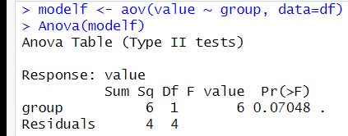
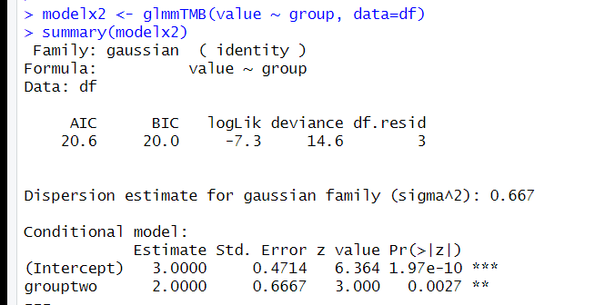

Methods to estimate parameters
Least squares
Maximum likelihood
Minimizes the sums of squares
$\sum{(y_{i}− \overline{y}}$)²
β = slope or intercept adjust
Only works for normal data
F-value for significance test
  F = MS_{B} / MS_{W}
Maximizes the likelihood function
$ℒ\left(\text{β} | y\right)$
β = slope or intercept adjust
Can be generalized to any distribution
χ2 for significance test
  χ2 = (effect size / SE)²

Slide 93
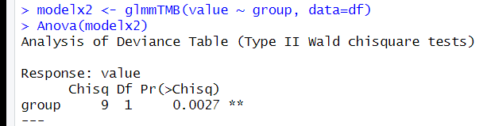
Methods to estimate parameters
Least squares
Maximum likelihood
Minimizes the sums of squares
$\sum{(y_{i}− \overline{y}}$)²
β = slope or intercept adjust
Only works for normal data
F-value for significance test
  F = MS_{B} / MS_{W}
Maximizes the likelihood function
$ℒ\left(\text{β} | y\right)$
β = slope or intercept adjust
Can be generalized to any distribution
χ2 for significance test
  χ2 = (effect size / SE)²

Slide 94
A very simple example of calculating a likelihood
Heads vs tails: Probability of getting a heads?
  P = 0.5
Two flips, probability of getting two heads?
  P(0.5) * P(0.5) = 0.25
What if we have an object with two sides (top, bottom) but we don’t know the probability of top vs bottom (probably not 50:50).
  Toss object 10 times, we get 7 tops and 3 bottoms (ie. We collected data)
  Log-likelihood: 7*log(p) + 3*log(1-p) = -6.1 when p=0.7
  Maximum likelihood: iterative process to find the optimum (maximum)
    Log-likelihood: 7*log(.5) + 3*log(1-.5) = -6.9

Slide 95
Step-by-step guide to analysis
(post-data collection)
4a. Model selection with AIC
Function | AIC | Test
lm() | bbmle::AICtab MuMIn::model.sel | Model comparison
lmer() | bbmle::AICtab MuMIn::model.sel | Model comparison
glmmTMB() | bbmle::AICtab MuMIn::model.sel | Model comparison

Slide 96
After break
Worked example
Overview Steps 1-4
Step 5: Calculate group means
Step 6: Conduct contrasts
Step 7: Calculate R2
Lunch break

Slide 97
Step-by-step guide to analysis
(post-data collection)
5. Estimate means and/or effect sizes
  emmeans(model, ~Treatment)
  Provides means and confidence intervals
  For transformed response variables, either via link function (glm) or in model, you can back transform means
    emmeans(model, ~Treatment, type=“response”)
    When backtransforming with multiple random effects (ie. glmer),
    you may need to use bias.adj=T
  emmtrends for slopes

Slide 98
Step-by-step guide to analysis
(post-data collection)
6. Compare means using contrasts
  emmeans(model, pairwise~Treatment)
  emmeans(model, pairwise~Treatment | Slices)
  emtrends(model, ~Treatment, var=“continuousvar”)
    For slopes

Slide 99
Step-by-step guide to analysis
(post-data collection)
7. Calculate R2
  R2 from performance
  r.squaredGLMM from MuMIn
  Note these use the same reference, but r2 values differ (not sure why, need to look into…)

Slide 100


Step-by-step guide to analysis
(post-data collection)
8. Visualize data
- Helpful for checking that parameters line up with raw plotted data, etc.

Slide 101
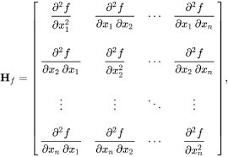

Troubleshooting with glmmTMB
Hessian matrix, what is it?
$$ℒ\left(\text{β} | y\right)$$
Likelihood of
observing the data
-1
0
1
Parameter value
https://cran.r-project.org/web/packages/glmmTMB/vignettes/troubleshooting.html

Slide 102

Troubleshooting with glmmTMB
Hessian matrix, what is it?
  When is it non-positive definite?
$$ℒ\left(\text{β} | y\right)$$
Likelihood of
observing the data
Likelihood of
observing the data
-1
0
1
-1
0
1
Parameter value
Parameter value
https://cran.r-project.org/web/packages/glmmTMB/vignettes/troubleshooting.html

Slide 103

Troubleshooting with glmmTMB
Hessian matrix, what is it?
  When is it non-positive definite?
$$ℒ\left(\text{β} | y\right)$$
Likelihood of
observing the data
Likelihood of
observing the data
-1
0
1
-1
0
1
Parameter value
Parameter value
https://cran.r-project.org/web/packages/glmmTMB/vignettes/troubleshooting.html

Slide 104
Troubleshooting with glmmTMB
Model convergence problem; non-positive-definite Hessian matrix; NA values for likelihood/AIC/etc.
  when a model is overparameterized (i.e. the data does not contain enough information to estimate the parameters reliably)
    Or problematic covariate (skewed, outliers, etc.)
  when a random-effect variance is estimated to be zero, or random-effect terms are estimated to be perfectly correlated ("singular fit": often caused by having too few levels of the random-effect grouping variable)
  when zero-inflation is estimated to be near zero (a strongly negative zero-inflation parameter)
  when dispersion is estimated to be near zero
  when complete separation occurs in a binomial model: some categories in the model contain proportions that are either all 0 or all 1
https://cran.r-project.org/web/packages/glmmTMB/vignettes/troubleshooting.html

Slide 105



